Slide 1
Assessing and understanding performance

Slide 2
Performance
Why is some hardware better than others for different programs? What factors of system performance are hardware related? (e.g., Do we need a new machine, or a new operating system?) How does the machine's instruction set affect performance?

Slide 3
11.3 Mathematical Preliminaries
Measures of system performance depend upon one’s point of view.
A computer user is most often concerned with response time: How long does it take the system to carry out a task?
System administrators are usually more concerned with throughput: How many concurrent tasks can the system handle before response time is adversely affected?
These two ideas are related: If a system carries out a task in k seconds, then its throughput is 1/k of these tasks per second.

Slide 4
Computer Performance: TIME, TIME, TIME
Response Time (latency) — How long does it take for my job to run? — How long must I wait for the database query?
Throughput — How many jobs can the machine run at once? — What is the average execution rate?
Exercise
If we add a new machine to the lab what do we increase?
If we upgrade a machine with a new processor what do we increase?
Notes:
For 1, only throughput is improved
For 2 both latency en throughput are improved

Slide 5
Execution Time
Elapsed Time
counts everything (disk and memory accesses, I/O , etc.)
a useful number, but often not good for comparison purposes
CPU time
doesn't count I/O or time spent running other programs
can be broken up into system time, and user time
Our focus: user CPU time
time spent executing the lines of code that are "in" our program
Notes:
System time is the time CPU deals with O.S. for the program

Slide 6
Book's Definition of Performance
For some program running on machine X, Performance_{X} = 1 / Execution time_{X}
"X is n times faster than Y" Performance_{X} / Performance_{Y} = n
What if:
machine A runs a program in 20 seconds
machine B runs the same program in 25 seconds
Notes:
Performance of A = 1/20 = 0.05
Performance of B = 1/25 = 0.04
Perf X / Perf Y = 0.05/0.04 = 1.25 or X is 1.25 times faster than Y

Slide 7
Clock Cycles
Instead of reporting execution time in seconds, we often use cycles (or number of cycles)
Clock “ticks” indicate when to start activities:
cycle time = time between ticks = seconds per cycle
clock rate (frequency) = cycles per second (1 Hz. = 1 cycle/sec) A 4 Ghz. clock has a cycle time
time

Slide 8
How to Improve Performance
So, to improve performance (everything else being equal) you can either (increase or decrease?) ________ the # of required cycles for a program, or ________ the clock cycle time
________ the clock rate.
CPU execution time for a program = no. of CPU clock cycles for a program
Clock rate
Notes:
Decrease # of cycles or
Decrease clock cycle
Or increase clock rate

Slide 9
Different numbers of cycles for different instructions
time
Multiplication takes more time than addition
Floating point operations take longer than integer ones
Accessing memory takes more time than accessing registers

Slide 10
CPI Example
Suppose we have two implementations of the instruction set architecture (ISA). As an example, for a program, Machine A has a clock cycle time of 250 ps and a CPI of 2.0 Machine B has a clock cycle time of 500 ps and a CPI of 1.2 Which machine is faster for this program, and by how much?
If two machines have the same ISA which of the following quantities will always be identical?
Clock rate,
CPI (Cycles Per Instruction),
Execution time,
# of instructions,
MIPS (Millions Instructions Per Second))
Notes:
For Mc A, it takes 2*250ps = 500ps per instruction
For B, it takes 1.2*500 = 600ps per instruction, so MC A is 1.2 times as fast as computer B for this program
For the same ISA, # of instructions will always be the same.

Slide 11
# of Instructions Example
A compiler designer is trying to decide between two code sequences for a particular machine. Based on the hardware implementation, there are three different classes of instructions: Class A, Class B, and Class C, and they require one, two, and three cycles (respectively). The first code sequence has 5 instructions: 2 of A, 1 of B, and 2 of C The second has 6 instructions: 4 of A, 1 of B, and 1 of C. 1. Which sequence will be faster? How much? 2. What is the CPI for each sequence?
Notes:
For A: the code sequence requires 2*1+1*2+2*3 = 10 cycles, totally
For B: 4*1+1*2+1*3=9 cycles per sequence
So, B is faster than A (take less cycles to complete the sequence)
A has 10/5 = 2 cycles per instruction
B has 9/6 = 1.5 cycles per instruction

Slide 12
MIPS example
Two different compilers are being tested for a 4 MHz. machine with three different classes of instructions: Class A, Class B, and Class C, which require one, two, and three cycles (respectively). Both compilers are used to produce code for a large piece of software. The first compiler's code uses 5 million Class A instructions, 1 million Class B instructions, and 1 million Class C instructions. The second compiler's code uses 10 million Class A instructions, 1 million Class B instructions, and 1 million Class C instructions.
1. Which sequence will be faster according to execution time?
2. Which sequence will be faster according to MIPS?
Notes:
Refer to page 269
Execution time for 1st: [(5x1+1x2+1x3) x 10^6] / 4x10^6=2.5sec
For 2nd: [(10*1+1*2+1*3) x 10^6] / 4x10^6=3.75 sec.
MIPS1 = (5+1+1) / 2.5 = 2.8
MIPS2 = 12 / 3.75 = 3.2

Slide 13
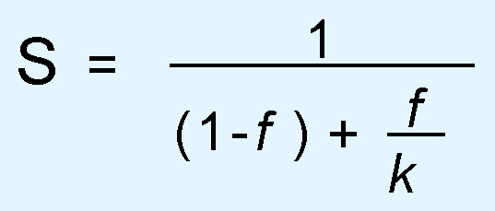
Amdahl’s Law
The overall performance of a system is a result of the interaction of all of its components.
System performance is most effectively improved when the performance of the most heavily used components is improved.
This idea is quantified by Amdahl’s Law:
where S is the overall speedup;
f is the fraction of work performed by a faster component; and
k is the speedup of the faster component.

Slide 14
Amdahl’s Law
Amdahl’s Law gives us a handy way to estimate the performance improvement we can expect when we upgrade a system component.
On a large system, suppose we can upgrade a CPU to make it 50% faster for $10,000 or upgrade its disk drives for $7,000 with a promise that two and a half times the throughput of existing disk will achieve.
Processes spend 70% of their time running in the CPU and 30% of their time waiting for disk service.
An upgrade of which component would offer the greater benefit for the same cost?

Slide 15
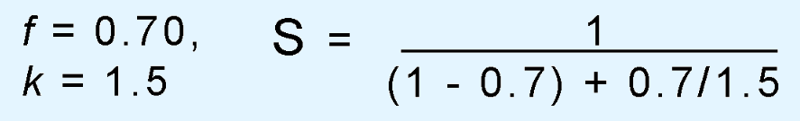
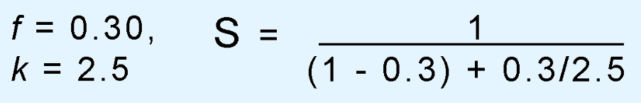
Amdahl’s Law
The processor option offers a 130% speedup:
And the disk drive option gives a 122% speedup:
Each 1% of improvement for the processor costs 10,000/30 = $333,
and for the disk a 1% improvement costs 7,000/22 = $318.
So, which improvement is the most cost effective?
Notes:
For processor, $10000/30% = $333 per 1% improvement
For disk, $7000/22% = $318 per 1% improvement

Slide 16
Amdahl's Law
Execution Time After Improvement = Execution Time Unaffected +( Execution Time Affected / Amount of Improvement )
Example: "Suppose a program runs in 100 seconds on a machine, with multiply responsible for 80 seconds of this time. How much do we have to improve the speed of multiplication if we want the program to run 4 times faster?" -How about making it 5 times faster?
Notes:
100/4 = (100-80) +(80/x)
25 = 20 + 80/x
5x = 80
X=16 or we have to improve the speed of multiplication for 16times of the original version.

Slide 17
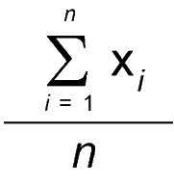
System performance
When we are evaluating system performance, we are most interested in its expected performance under a given workload.
We use statistical tools that are measures of central tendency.
The one with which everyone is most familiar is the arithmetic mean (or average), given by:

Slide 18
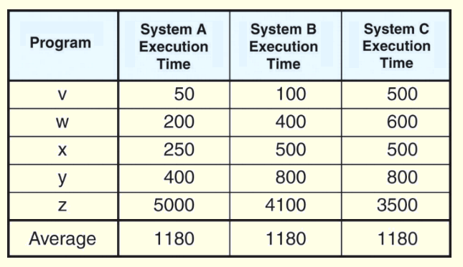
System performance
The arithmetic mean can be misleading if the data are skewed or scattered.
Consider the execution times given in the table below. The performance differences are hidden by the simple average.

Slide 19
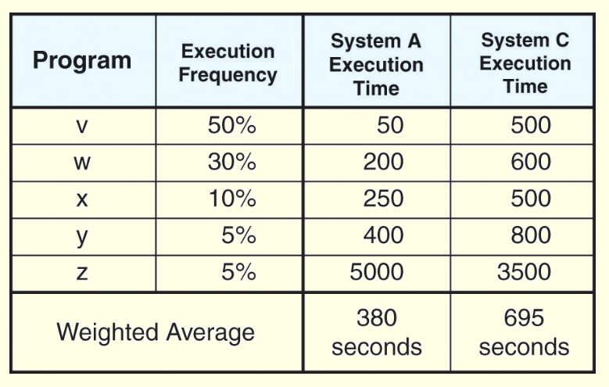
System performance
If execution frequencies (expected workloads) are known, a weighted average can be revealing.
The weighted average for System A is:
50 × 0.5 + 200 × 0.3 + 250 × 0.1 + 400 × 0.05 + 5000 × 0.05 = 380.

Slide 20
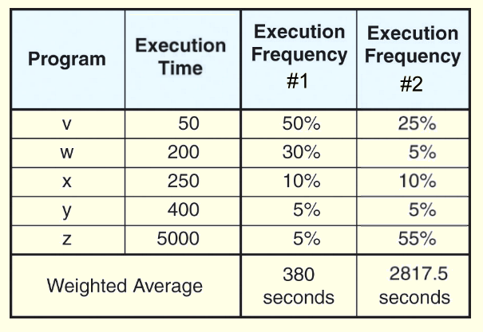
System performance
However, workloads can change over time.
A system optimized for one workload may perform poorly when the workload changes, as illustrated below.

Slide 21
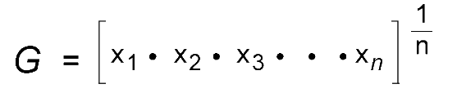
System performance
When comparing the relative performance of two or more systems, the geometric mean is the preferred measure of central tendency.
It is the n^{th} root of the product of n measurements.
Unlike the arithmetic means, the geometric mean does not give us a real expectation of system performance. It serves only as a tool for comparison.

Slide 22
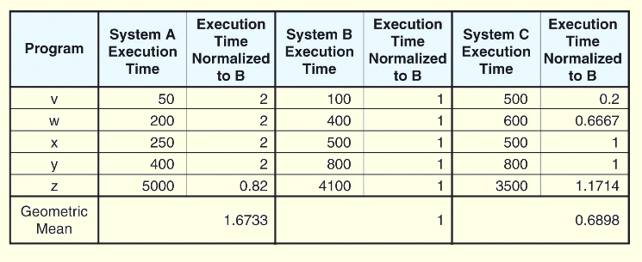
System performance
The geometric mean is often uses normalized ratios between a system under test and a reference machine.
We have performed the calculation in the table below.
Notes:
Select a system to be a base, e.g. system b, so the normalized time for B = 100/100, for A = 100/50, and for C = 100/500.

Slide 23
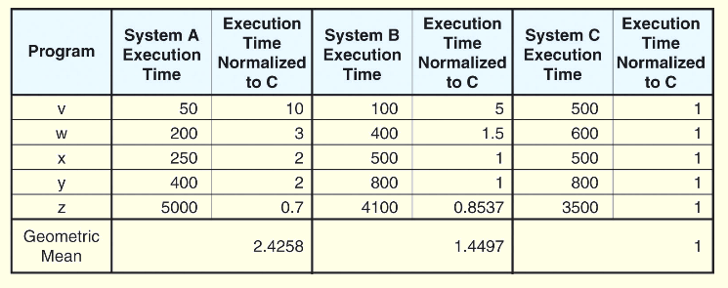
System performance
When another system is used for a reference machine, we get a different set of numbers.

Slide 24
System performance
The real usefulness of the normalized geometric mean is that no matter which system is used as a reference, the ratio of the geometric means is consistent.
This is to say that the ratio of the geometric means for System A to System B, System B to System C, and System A to System C is the same no matter which machine is the reference machine.

Slide 25
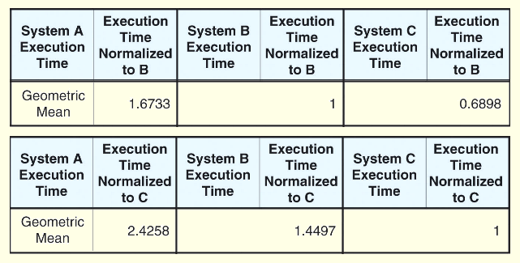
System performance
The results that we got when using System B and System C as reference machines are given below.
We find that 1.6733/1 = 2.4258/1.4497.

Slide 26
System performance
The inherent problem with using the geometric mean to demonstrate machine performance is that all execution times contribute equally to the result.
So shortening the execution time of a small program by 10% has the same effect as shortening the execution time of a large program by 10%.
Shorter programs are generally easier to optimize, but in the real world, we want to shorten the execution time of longer programs.
Also, as the geometric mean is not proportionate. A system giving a geometric mean 50% smaller than another is not necessarily twice as fast!
Geometric mean of A = (10 x 20 x 30)^(1/3) = 18.17 mph
Geometric mean of B = (20 x 40 x 60)^(1/3) = 34.64 mph

Slide 27
System performance
The harmonic mean provides us with a way to compare execution times that are expressed as a rate.
The harmonic mean allows us to form a mathematical expectation of throughput, and to compare the relative throughput of systems and system components.
To find the harmonic mean, we add the reciprocals of the rates and divide them into the number of rates:
H = n ÷ (1/x₁+1/x₂+1/x₃+ . . . + 1/x_{n})

Slide 28
System performance
The harmonic mean holds two advantages over the geometric mean.
First, it is a suitable predictor of machine behavior.
Not a normarized ratio as usually done in geometric.
Second, the slowest rates have the greatest influence on the result, so improving the slowest performance-- usually what we want to do-- results in better performance.
More conservative than geometric, e.g. for a set of 5 task
Task 1: 10s Task 2: 15s Task 3: 20s Task 4: 25s Task 5: 30s
Harmonic mean 5 / [(1/10) + (1/15) + (1/20) + (1/25) + (1/30)] = 16.3s
Geometric mean = (10 x 15 x 20 x 25 x 30)^(1/5) = 19.7 s

Slide 29
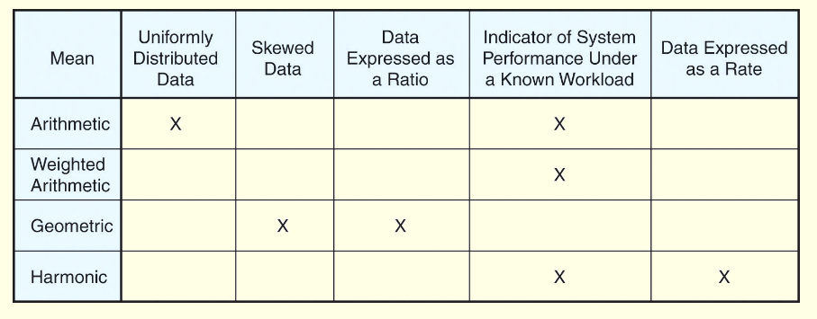
System performance
This chart summarizes when the use of each of the performance means is appropriate.

Slide 30
System performance benchmark
The objective assessment of computer performance is most critical when deciding which one to buy.
For enterprise-level systems, this process is complicated, and the consequences of a bad decision are grave.
Unfortunately, computer sales are as much dependent on good marketing as on good performance.
The wary buyer will understand how objective performance data can be slanted to the advantage of anyone giving a sales pitch.

Slide 31
Benchmarking
Many people erroneously equate CPU speed with performance.
Measures of CPU speed include cycle time (MHz, and GHz) and millions of instructions per second (MIPS).
Saying that System A is faster than System B because System A runs at 1.4GHz and System B runs at 900MHz is valid only when the ISAs of Systems A and B are identical.
With different ISAs, it is possible that both of these systems could obtain identical results within the same amount of wall clock time.
31
Notes:
31

Slide 32
Benchmarking
Performance benchmarking is the science of making objective assessments concerning the performance of one system over another.
Price-performance ratios can be derived from standard benchmarks.
Example benchmarking report:
https://www.spec.org/benchmarks.html#cpu
https://www.geekbench.com
32
Notes:
32

Slide 33
End of Lecture

